Slide 1
Data Literacy Series: Training #4
Reflection and Direction for Continuous Improvement
Division of Field Support and Services
Office of Comprehensive Support
April 10, 2024

Slide 2
Please Review
The New Jersey Department of Education may record audio, visuals, participants, and other information sent, verbalized, or utilized during business-related meetings. By joining this meeting, you automatically consent to such recordings. Any participant who prefers to participate via audio only should keep their camera disabled so only their audio will be captured.
PLEASE NOTE: Under certain circumstances, audio/video recording may be restricted. Recording will be in accordance with all applicable federal, state, and local statutes, regulations, or ordinances. As we endeavor to offer a safe, collegial, and inclusive space for collaboration we respectfully request that no participant or third-party entity, on your behalf, record or transcribe today’s conversation. The NJDOE can provide a transcript of these proceedings, upon request. Screenshots, photography, or other copying of chat exchanges is prohibited unless permission is granted by the NJDOE and advance notice is provided to all participants.

Slide 3
Welcome

Slide 4
Agenda for Today
Annual School Plans & S.M.A.R.T. Goals
School Performance Reports
Voices from the Field: Union City
Completion of Cycle III Record Book
Next Steps
Questions & Answers

Slide 5
Annual School Plans and S.M.A.R.T. Goals

Slide 6
Acronyms To Know
ASP – Annual School Plan
ASPS – e-Annual School Planning System
CNA - Comprehensive Needs Assessment
ESSA – Every Student Succeeds Act
PPN – Priority Performance Need
OCS – Office of Comprehensive Support
RCA - Root Cause Analysis
RST – Regional Support Team
SIA – School Improvement Award
S.M.A.R.T.
SPR – School Performance Reports

Slide 7
S.M.A.R.T. Goals - Definition
Area | Description
Specific | Focuses on a single, specific student, personnel, or stakeholder outcome (if Targeted school, focuses on identified subgroup).
Measurable | Includes a quantifiable metric (i.e. number, percent, percentile, etc.) to be reached.
Attainable | Is something that a school may plausibly achieve with effort.
Relevant | Is directly relevant to improving an accountability metric.
Time-bound | Has a target date/month to be achieved within the project period.

Slide 8
S.M.A.R.T. Goals - Examples
By May 1, 2025 at least eight of ten ELL teachers will receive a rating of proficient or better on the School X bilingual instructional supports rubric.
Specific
By June 2025 the chronic absenteeism rate for 6th grade will see a year-over-year reduction from 35% to 25%.
Measurable
By December 2024 95% of 9th grade students will be placed in on-time graduation support tiers based on their core course grade, attendance, and disciplinary referrals.
Attainable
Relevant
By May 2025, 90% of 8th grade students who attended after school tutoring in mathematics anchor skills regularly (75% of sessions) will meet their end-of-year growth targets on the _____ mathematics assessment platform.
Time-bound

Slide 9
S.M.A.R.T. Goals - Examples
By May 1, 2025 at least eight of ten ELL teachers will receive a rating of proficient or better on the School X bilingual instructional supports rubric.
Specific
By June 2025 the chronic absenteeism rate for 6th grade will see a year-over-year reduction from 35% to 25%.
Measurable
By December 2024 95% of 9th grade students will be placed in on-time graduation support tiers based on their core course grade, attendance, and disciplinary referrals.
Attainable
Relevant
By June 15, 2025, 90% of 8th grade students who attended after school tutoring in mathematics anchor skills regularly (75% of sessions) will meet their end-of-year growth targets on the _____ mathematics assessment platform.
Time-bound

Slide 10
Interim Goals
Every SMART Goal must include quarterly interim goals to be met at the end of each cycle, which should be designed to measure progress toward the overall goal. Progress monitoring data related to these interim goals are due on:
  November 15
  February 15
  April 15
Interim goals, like the overall SMART Goal, should be Specific, Measurable, Attainable, Relevant, and Time-bound.

Slide 11
Leading Indicators for Interim Goals
Your interim goals should be designed with "leading indicators" in mind to ensure progress toward the overall SMART Goal. A common way of developing these interim goals is:
  An increasing percentage of teachers implementing a practice with fidelity as the year progresses as indicated by learning walks, leading to near-full implementation by the end of the year.
  An increasing percentage of students meeting a proficiency/growth goal at each checkpoint as evidenced by assessment data, leading to the achievement of an annual proficiency/growth target.
  Not exceeding a set percentage of disciplinary referrals/chronically absent students at each checkpoint, leading to an overall decrease in referrals/chronic absenteeism by the end of the year as compared to the prior year.

Slide 12
Leading Indicators for Interim Goals
Thoughtful planning and increasing your familiarity with evidence-based programs and interventions will help you identify the leading indicators that inform the development of your interim goals. For example:
  For a effective instruction interim goal, increase the percent of lesson passed on a learning platform in addition to the percent of students that will complete the benchmark assessment.
  For an SEL interim goal, reduce the percentage of students requiring Tier 3 behavioral supports, and/or ensure that a set percentage of students have received positive office referrals/phone calls home.

Slide 13
The Ghost of S.M.A.R.T. Goals Past
 | 2022-23
Total Number of Goals | 1,040
% Specific | 46.2%
% Measurable | 90.9%
% Attainable | 92.9%
% Relevant | 63.2%
% Time-bound | 53.5%
% Meeting ≥ 3 Criteria | 83.3%
% Meeting ≥ 4 Criteria | 57.2%
% Meeting All Criteria | 25.1%

Slide 14
The Ghost of S.M.A.R.T. Goals Past
 | Examples | 2022-23 Goals
Word Count | 22.5 | 34.1 (52% longer)
Character Count | 142.8 | 213.6 (50% longer)
MATH
By June 2023, 65% of Math and ELA students, grades 6-8, will have met or exceeded their individual growth target as set by their respective teachers using baseline scores obtained from benchmark data.
Students will have individual growth targets set and be assessed four times a year according to the following skills in ELA and Math: Vocabulary, Silent Reading Fluency, Reading Comprehension, Oral Reading Fluency, Number Systems, Geometric Functions, and Modeling and Reasoning. Target scores will be tiered and vary among students based on student needs.
iReady diagnostic will serve as a standardized benchmarking tool for our ELA department. i-Ready Diagnostic is an adaptive assessment designed to provide teachers with actionable insight into student needs. This diagnostic pinpoints student ability level, identifies the specific skills students need to learn to accelerate their growth and charts a personalized learning path for each student.
IXL Real-Time Diagnostic will be used as our standardized benchmarking tool. Teachers will have students work in the diagnostic arena weekly and we will use quarterly snapshots to measure student progress. Using insights from the Real-Time Diagnostic, IXL creates a personalized action plan for each student. With these recommended skills, you have a simple way to differentiate instruction, fill individual knowledge gaps, and facilitate meaningful progress.
214
1425

Slide 15
School Performance Reports

Slide 16
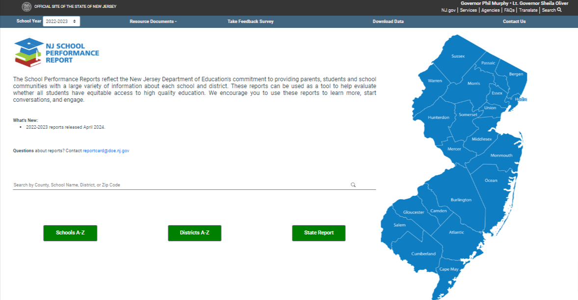
School Performance Reports
Available at: https://rc.doe.state.nj.us/

Slide 17
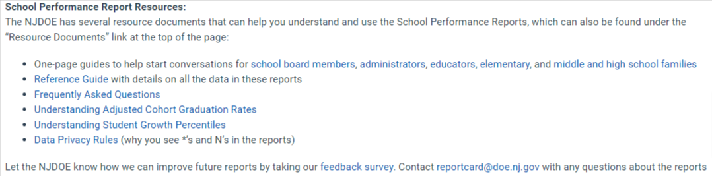
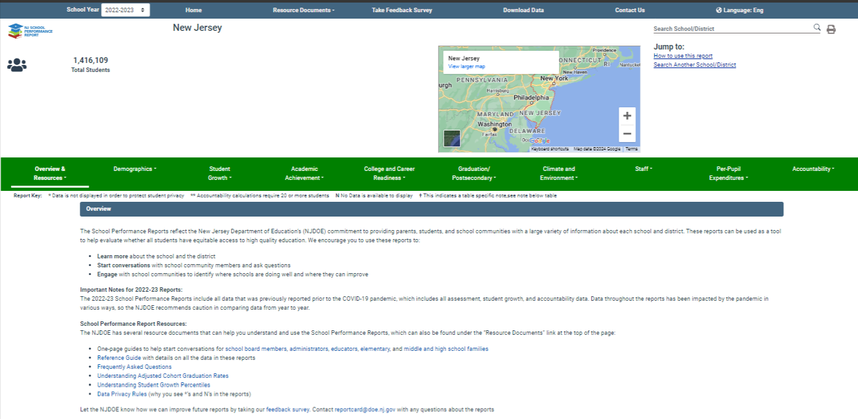
School Performance Reports

Slide 18
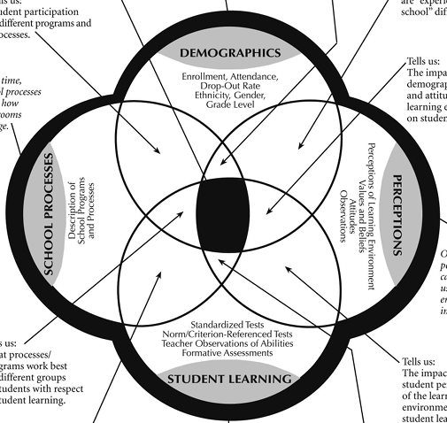
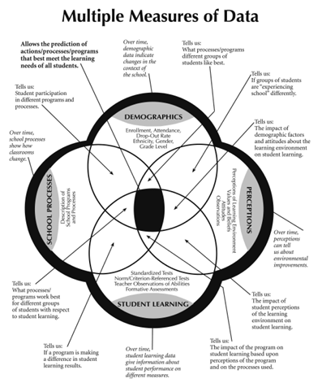
Multiple Measures of Data
Source: Bernhardt, V. L. (2013). Data Analysis for Continuous School Improvement. Third Edition. New York, NY: Routledge. Page 17.

Slide 19
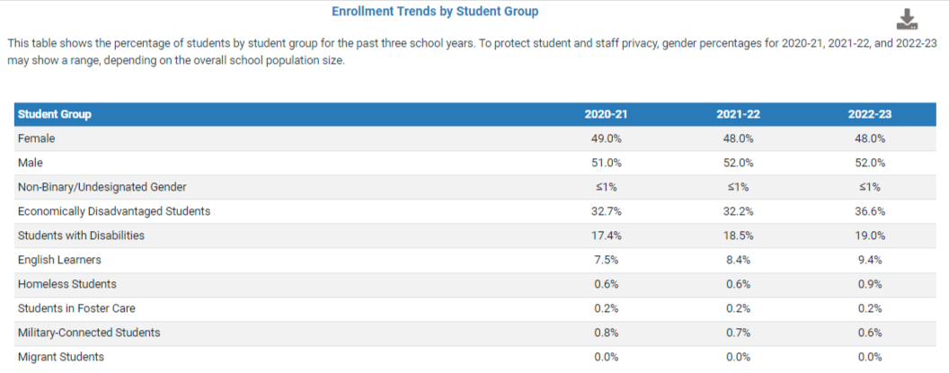
SPRs + Multiple Measures of Data
I
Demographics:
How prevalent are students with disabilities in New Jersey?

Slide 20
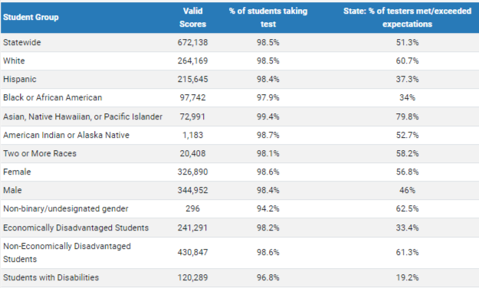
SPRs + Multiple Measures of Data
II
Demographics + Student Learning:
How did students with disabilities perform on the ELA NJSLA in 2022-23?

Slide 21
SPRs + Multiple Measures of Data
III
Demographics + Student Learning + Processes:
How did students with disabilities who received after school tutoring perform on the ELA NJSLA in 2022-23?
IV
Demographics + Student Learning + Processes + Perceptions:
How did students with disabilities who received after school tutoring and reported the tutoring as helpful perform on the ELA NJSLA in 2022-23?

Slide 22

Break
We will take a five-minute stretch break.

Slide 23
Presenters: Union City Public Schools
Silvia Abbato | Superintendent
John Bennetti | Assistant Superintendent
Michael Cirone | Principal & Testing Coordinator
Krystle Santaniello | District ELA Supervisor

Slide 24

Union City Public Schools
What data do you feel are most important to drive instructional decision-making at the classroom, school, and district levels?
NJSLA Scores
Accountability Profiles
District Assessment Data
Diagnostic Assessments DORA/DOMA/ADAM
High Impact Tutoring Data
Formative/Summative Classroom Assessments

Slide 25

Union City Public Schools
How has data impacted programs, policy, or practice with Union City Public Schools?
Practice
Programs
Policy

Slide 26

Union City Public Schools
Are there particular resources you’ve found helpful in building a data-literate culture among personnel within the district?
Sharing reports with analysis by Central Office for the Administrative Teams to use and share with staff
Professional Development offerings that MUST entail a data-use component
Hosting weekly Professional learning community meetings where data is tracked, discussed and analyzed to determine areas of needs and strengths.

Slide 27

Union City Public Schools
How is formative assessment used within the district to support teaching and learning?
Within the day, within the instructional block (i.e., student grouping decisions within the block? Reteaching of content? differentiation)
Within the day, outside of the instructional block (i.e., lunchtime tutoring, academic coaching support - pullout)
Outside of the day (i.e., placement into supplemental tutoring/enrichment programming)

Slide 28

Union City Public Schools
What is the primary message you hope to communicate to personnel regarding data use within Union City Public Schools?
Informed Decision Making - Data use is meant to validate a teacher’s decision-making regarding his/her students’ needs
Learning Gaps - data use enables teachers to identify the gaps and assists in acceleration attempts
Evidence-Based Decisions - data use provides teachers with concrete evidence regarding the effectiveness of strategies, materials, etc.
Data use allows for an easier progress-monitoring of student achievement over time
Data use is critical for supporting students requiring specialized need/programming
Data drives instructional decision making, as well as professional development needs in district and school buildings.

Slide 29
 | # of Schools in District | # of Identified Schools in District (%) | % of District Identified | % of District ESSA Goals Met (2022-23) | High Needs Students (ELL + FRPL + SWD) | Average NJSLA/DLM Proficiency | Average mSGP
Union City | 14 | 0 | 0.0% | 71.2% (T-6th) | 126.9 (3rd) | 45.6 (17th) | 58.5 (3rd)
Districts with ≥ 10 schools (N = 44) | 16 | 2.5 | 13.1% | 57.6% | 69.1 | 39.9 | 48.8

Slide 30
Cycle Reporting

Slide 31
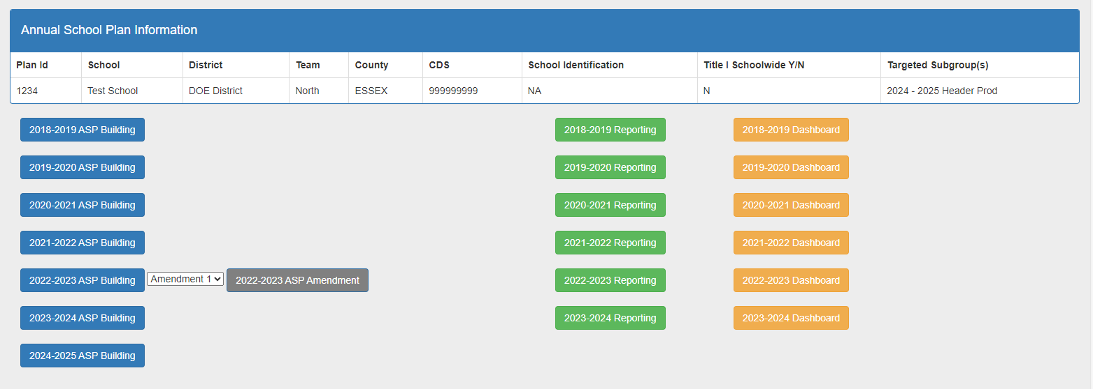
Cycle Reporting
N.J.A.C. 6A:33 (Chapter 33 - School Turnaround and Improvement) ASP teams are required to meet at least four times a year to assess progress toward ASP goal attainment. ASP teams must also share their data with their assigned field support team throughout the year (this happens during the Cycle Review process). For districts with no Comprehensive schools and less than three Targeted schools, they must monitor ASP team’s progress in implementation as their schools do not have an assigned field support team.

Slide 32
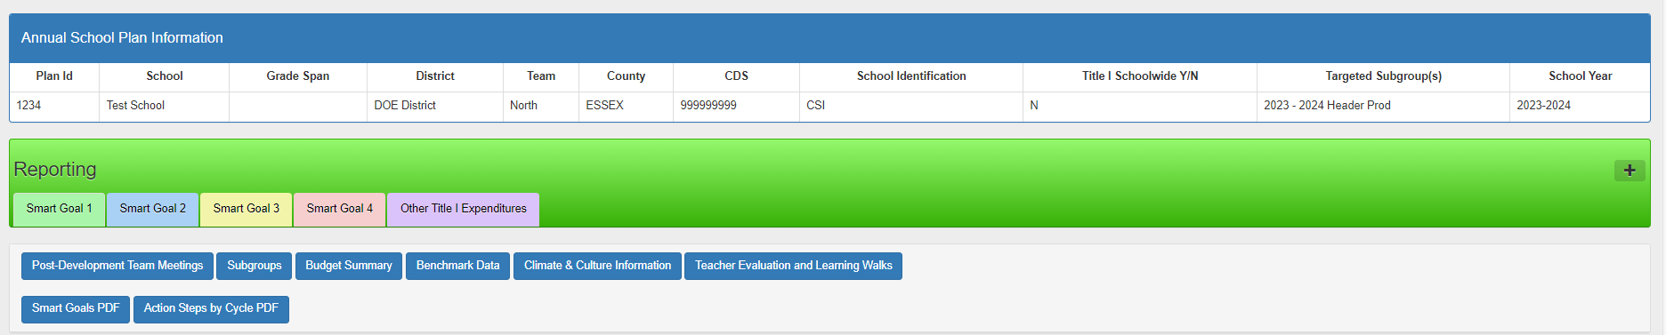
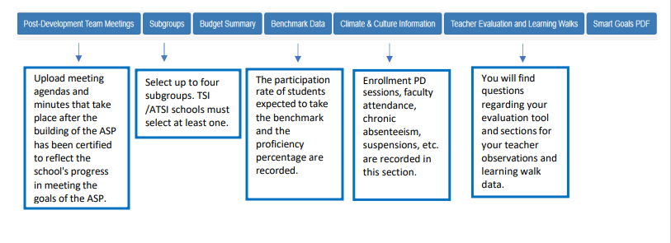
Progress Monitoring

Slide 33
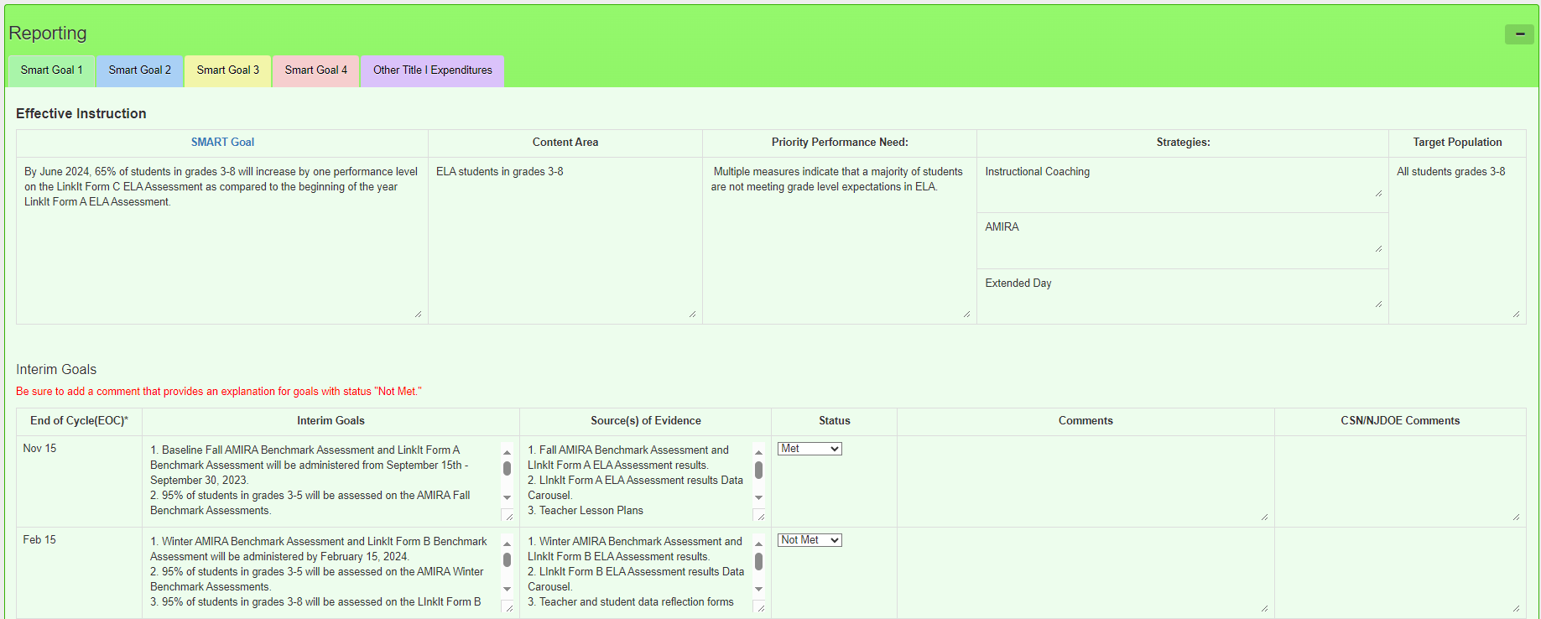
Review Interim Goals

Slide 34
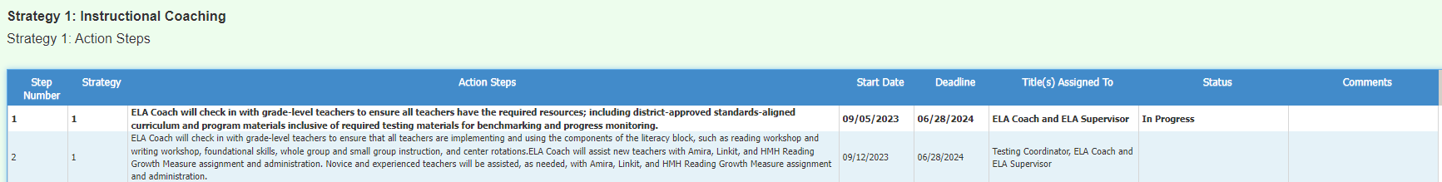
Strategy Implementation
Status of Action Steps
Expenditures

Slide 35

End of Cycle Review Meetings
What are End of Cycle Review Meetings?
Collective Efficacy
Four times a year, Comprehensive and Targeted schools are required to analyze and reflect upon data related to academic achievement, culture and climate, and progress towards their Annual School Plan (ASP) S.M.A.R.T. goals. (N.J.A.C. 6A:33)
These End of Cycle (EOC) meetings are collaborative, reflective, problem-solving meetings, rooted in data, about the school’s progress towards its annual goals and action steps.
In 2024, the Cycle 3 Review process will be done internally and independently by schools, in consultation with their district, and audited virtually by the Office of Comprehensive Support.

Slide 36
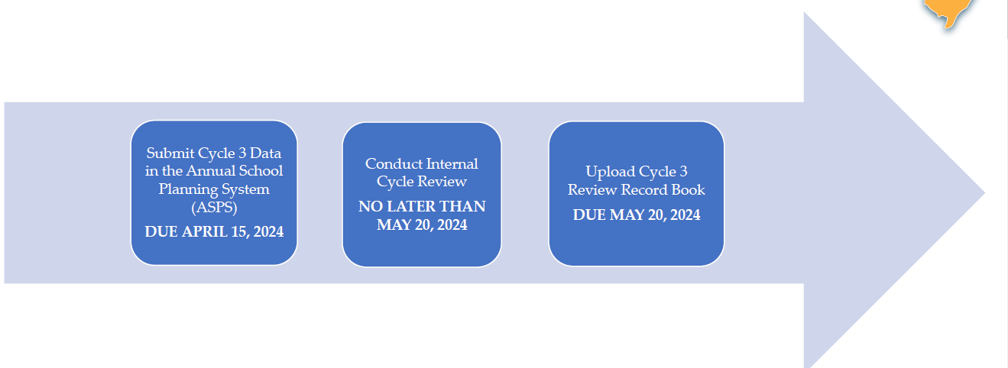
Cycle 3 Review Process

Slide 37
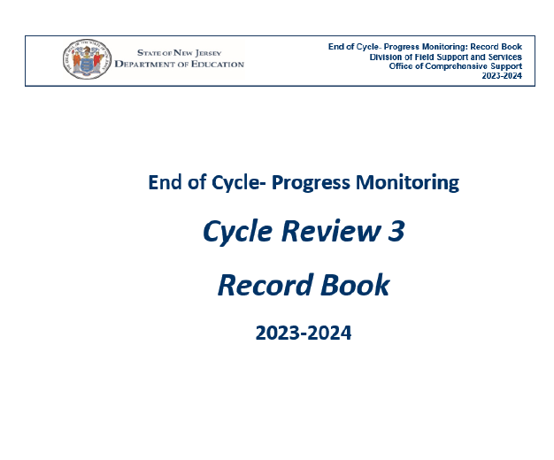
Cycle 3 Record Book
In a school leadership team meeting, collaboratively complete this record book.
It asks questions related to your Cycle 3 data, including any shifts your team made as a result of analyzing the data.
Save your work in the Record Book and upload the file in the ASPS.

Slide 38
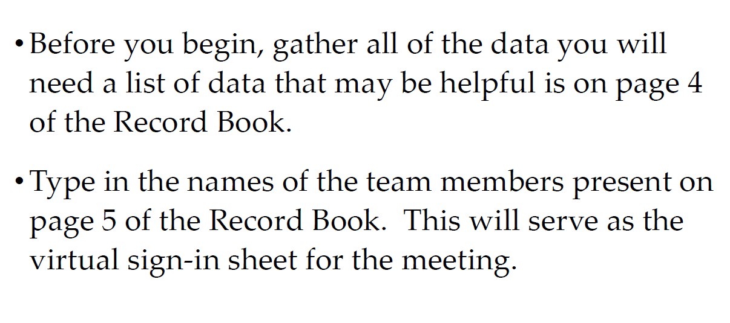
Getting Started

Slide 39
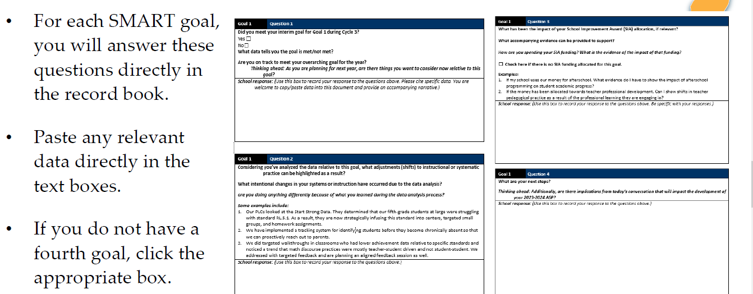
EOC Questions

Slide 40
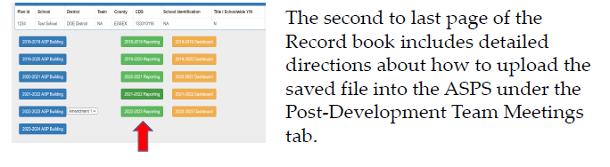
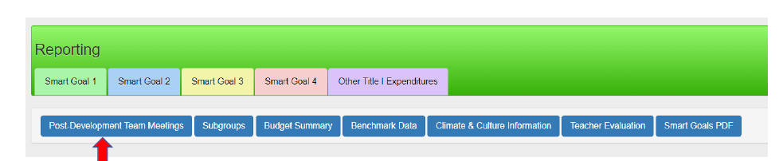
Uploading the Record Book

Slide 41
Next Steps

Slide 42
Next Steps
Complete a robust CNA including a high-quality RCA to determine your PPNs
CDS has been open since March 20th and will remain open until May 8th for updates to district and school-level data
Reach out to Office of Special Education as needed for additional support

Slide 43
Presenter Contact Information
Jennifer Hobbs
Data Specialist, RST-North
(973) 902-6969
jennifer.hobbs@doe.nj.gov
Reina Irizarry-Clark
Data Specialist, RST-Central
(609) 658-0366
reina.irizarry-clark@doe.nj.gov
Lindsay Wilhelmi-Guay
Data Specialist, RST-South
(856) 301-0087
lindsay.wilhelmi-guay@doe.nj.gov
Dr. Chimaobi Amutah
Statewide Data Manager
State Transformation Specialist
(609) 468-7349
chimaobi.amutah@doe.nj.gov
Matthew Norcross
Data Analyst
(856) 372-0238
matthew.norcross@doe.nj.gov

Slide 44
Questions

Slide 45
Thank You!
New Jersey Department of Education: nj.gov/education
Office of Comprehensive Support: OCS@doe.nj.gov
ASP Technical Support: ASP@doe.nj.gov
Follow Us!
Facebook:
@njdeptofed
Twitter: @NewJerseyDOE
Instagram:
@NewJerseyDoe

